Slide 1
MAKE A GMAIL ACCOUNT
Elaine Munn

Slide 2
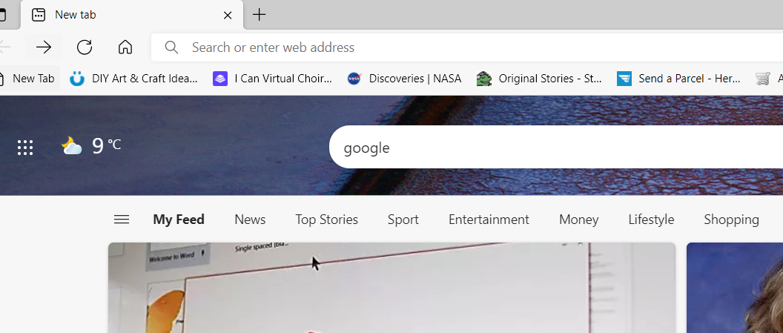
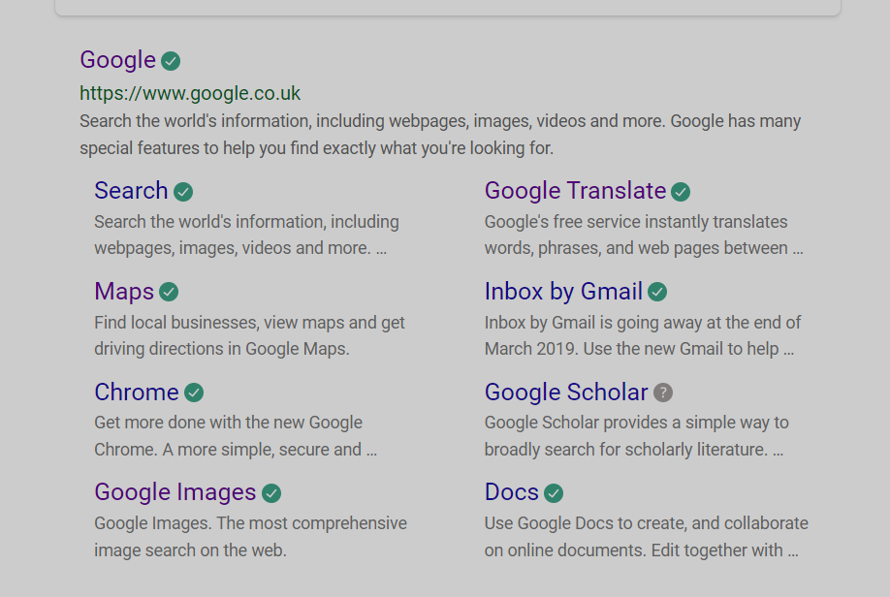
STEP 1
In the Internet Browser
TYPE GOOGLE into the search bar
CLICK ON THE HYPERLINK Inbox by Gmail

Slide 3
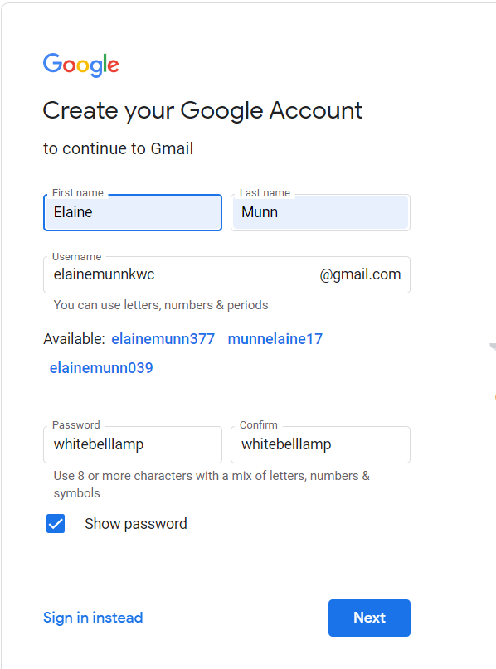
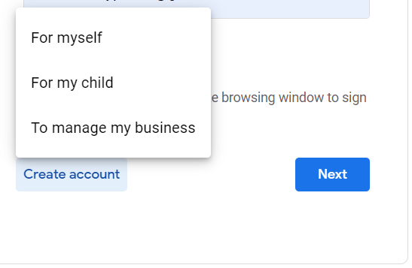
CLICK ON CREATE ACCOUNT CHOOSE FOR MYSELF
Use your own name or click on one of the suggested
Fill in online form
For the password I used 3 random words white bell lamp
CLICK NEXT

Slide 4
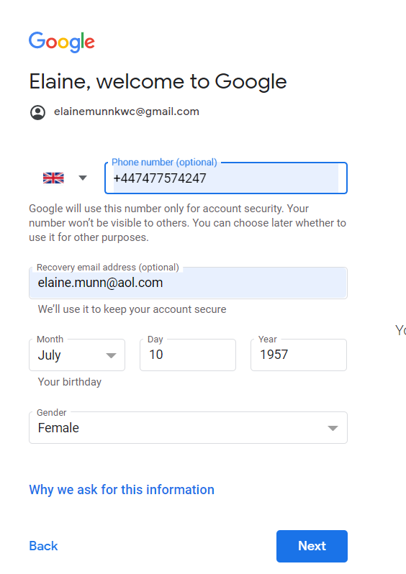
NOTE: It says OPTIONAL
Click on the link if you want to know what your info is used for
CLICK NEXT

Slide 5
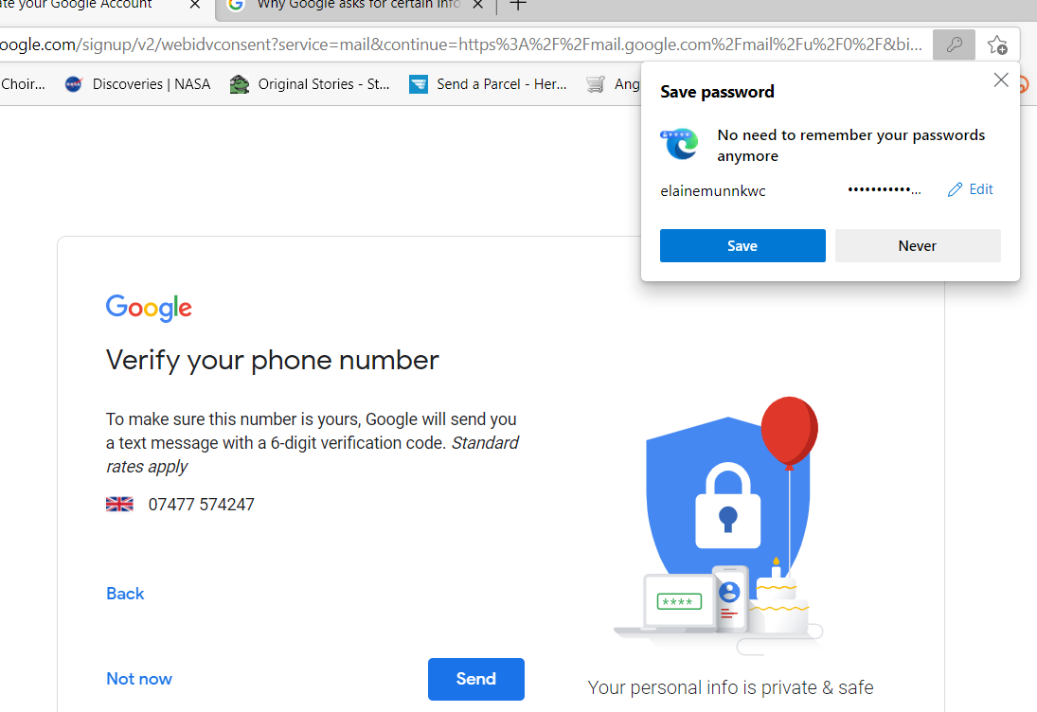
If you are on YOUR OWN COMPUTER SAVE
CHOOSE NEVER for a computer that does not belong to you

Slide 6
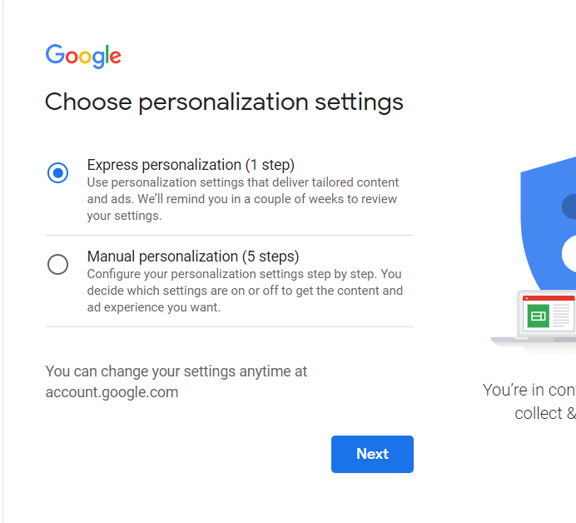
You MUST Choose an option
CLICK NEXT

Slide 7
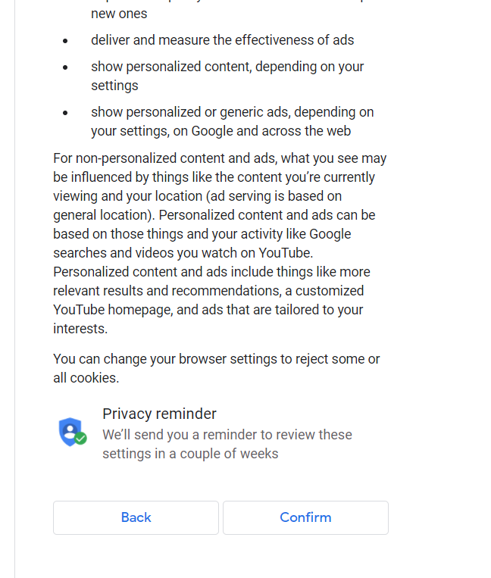
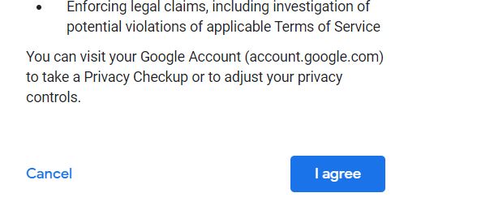
You MUST SCROLL DOWN AND CHOOSE CONFIRM
You MUST SCROLL DOWN AND CHOOSE I agree

Slide 8
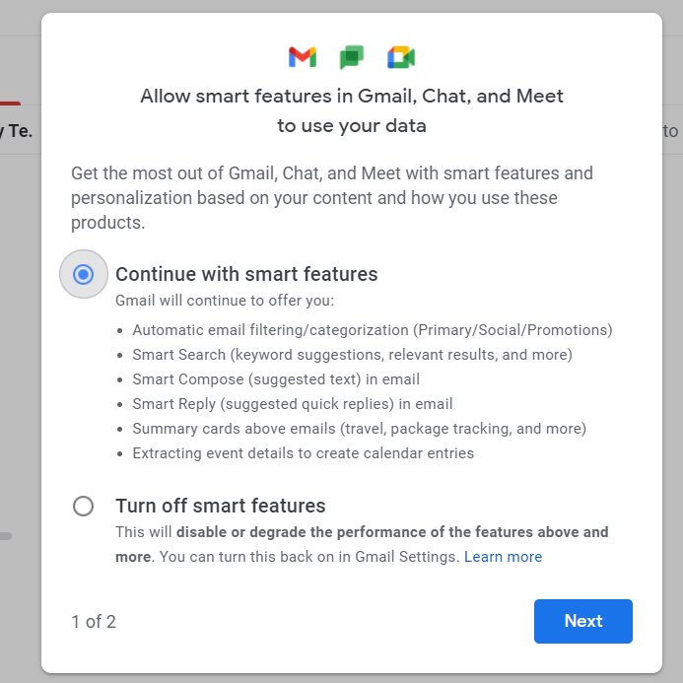
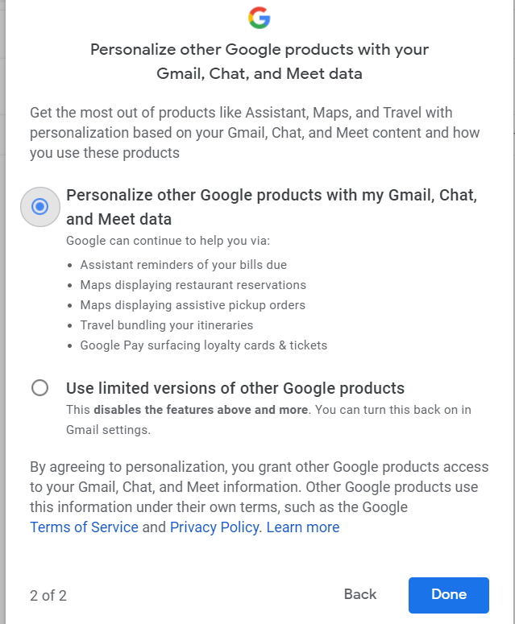
Choose one and CLICK NEXT
Choose one and CLICK DONE

Slide 9
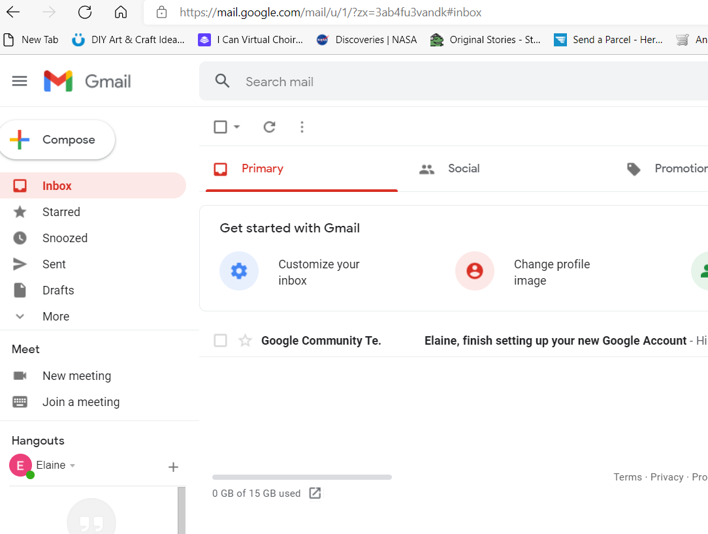

Slide 10
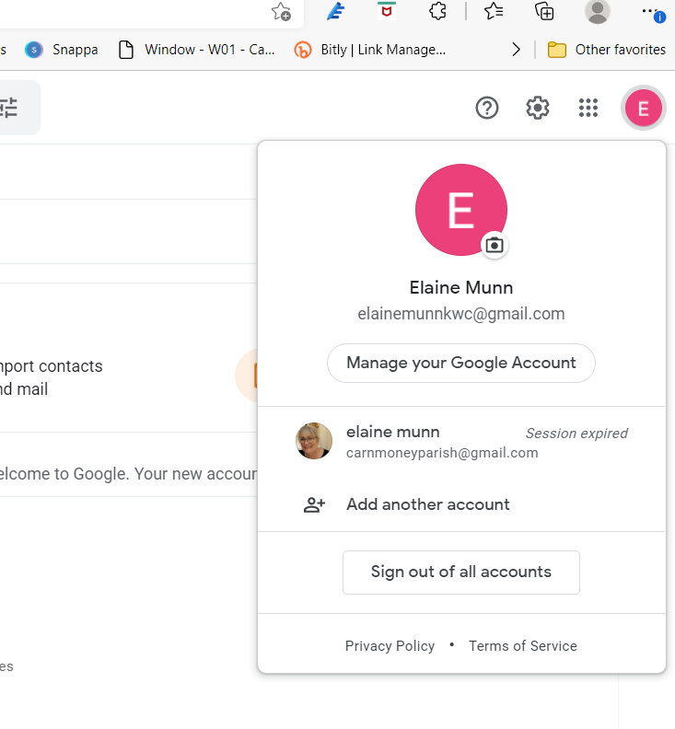
MAKE SURE YOU SIGN OUT
CLICK HERE
SIGN OUT

Slide 11
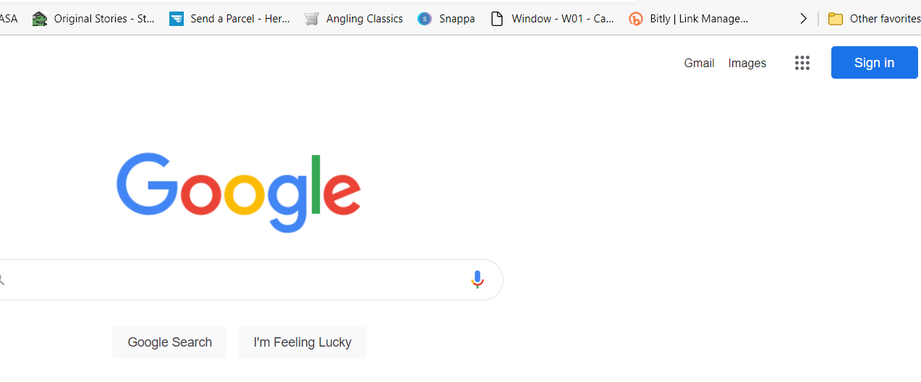
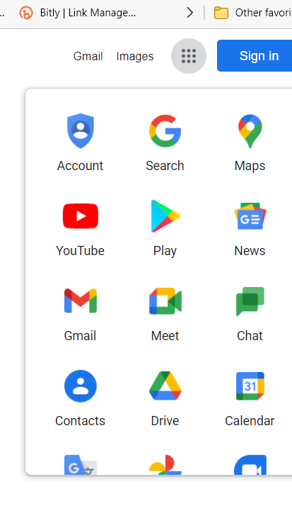
TO SIGN IN
CLICK GMAIL
CLICK on the GRID to see more GOOGLE options
OR
Choose Gmail

