Slide 1
Social Media Intro.
Elaine Munn

Slide 2
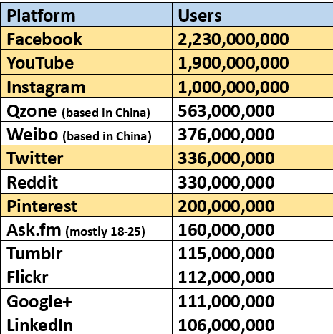
There are about 212 Social media platforms
Most popular 2018

Slide 3
Categories of social media
Social networking
Image Sharing Sites
Video Hosting sites
Community Blogs
Discussion Sites
Sharing economy networks
Social review Sites
Gaming
Dating sites

Slide 4
Social Networking
Users can share thoughts, create content, upload photos and videos, form groups based on interests, and participate in lively discussions.
They’re built around the user and everything that’s important to them and their social circles.

Slide 5
Image Sharing Sites
Instagram, Imgur and Snapchat amplify the power of image sharing.
Create and share images that spark conversation.
A picture can be worth a thousand words
Run campaigns encouraging users to snap and share a picture with your product and a unique hashtag.
By creating and sharing your own images, you can inspire and engage users.

Slide 6
Video Hosting Sites
YouTube revolutionized the way we watch, create, and think about video.
Video hosting platforms like YouTube and Vimeo help creators put together content and share it to a platform optimized for streaming.
Use video hosting sites to:
Share phenomenal content: Use YouTube to build communities and get their content out there.
Engage: YouTube’s comment section offers plenty of opportunities to get to know the people watching your content.

Slide 7
Community Blogs & Blogs
Sometimes an image or post isn’t complex enough for the message you’ve got to share.
Shared blogging platforms like Medium and Tumblr give people a space to express their thoughts and help connect them with readers.
https://medium.com/
https://www.tumblr.com/
Create your own blog: https://www.wix.com/
This Photo by Unknown Author is licensed under CC BY

Slide 8
Discussion Sites
Discussion sites like Reddit and Quora are specifically designed to spark a conversation. Anyone is free to ask a question or make a statement, and this attracts people with shared interests and curiosities.
So how can these platforms help your business?
Reddit made up of different sub-communities. Find and engage people in your field, discover what they’re asking, use this as a starting point for your content marketing strategy.
Quora users ask all sorts of questions. Answering them can help establish you as a thought leader and drive more traffic to your site.
https://www.reddit.com/ https://www.quora.com/

Slide 9
Sharing Economy Networks
Sharing economy networks bring people who’ve got something they want to share together with the people who need it.
https://www.airbnb.co.uk/ Rent out your home
https://www.vinted.com/ - don’t wear it? Sell it
https://www.spinlister.com/ - Skiers, Cyclists, surfers rent out their equipment
https://www.justpark.com/ - Rent out your Drive – Park at my house
https://www.blablacar.co.uk/ - Car pooling – Find a ride/offer a ride
https://dogvacay.com/ - Pet Sitters and Pet walkers
https://www.uber.com/ - Taxi

Slide 10
Social Review Sites
A review site is a website on which reviews can be posted about people, businesses, products, or services.
https://marketing.trustpilot.com/ - Google
https://www.tripadvisor.co.uk/ - Hotels, Things to do, holidays etc.
https://www.autocar.co.uk/ - Car reviews
https://www.which.co.uk/ - 1000s of product reviews
https://www.reviews.co.uk/ - Google reviews https://blog.reviews.io/google-business-reviews-ultimate-guide/
You can also get reviews on, Facebook, Amazon, eBay most selling sites

Slide 11
More Social Networking
Online gaming - more accessible and social than ever.
multiplayer games & social networking in gaming.
understand what these social gaming platforms are and help children to understand how to chat safely online without putting themselves at risk.
Online dating (or Internet dating)

Slide 12
List of sites mentioned in this presentation
https://www.facebook.com/
https://www.youtube.com/
https://twitter.com/
https://www.youtube.com/yt/kids
https://vimeo.com/
https://www.vinted.co.uk/
https://www.instagram.com/
https://www.snapchat.com/
https://imgur.com/
https://www.wix.com/
https://www.reddit.com/ https://www.quora.com/
https://www.proboards.com/
https://medium.com/
https://www.tripadvisor.co.uk/
https://www.tumblr.com/

