Slide 1
Internet Safety – Social Media
Elaine Munn

Slide 2
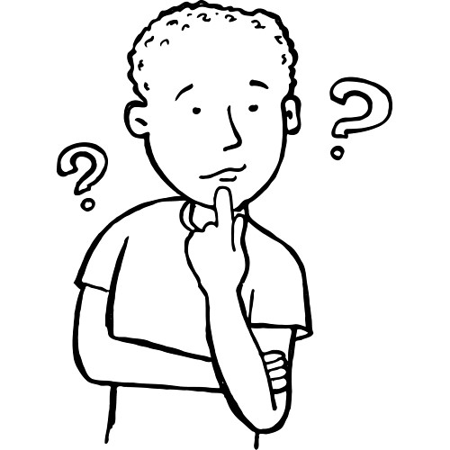
Watch your back
Whenever you're about to post something online, pause and just imagine someone in authority, someone you respect, reading that post or looking at that photo. If that feels uncomfortable, don't do it. **REMEMBER** comments you’ve made in the past can come back to bite you!!

Slide 3
Got a nickname/pseudonym?
Think about using a nickname instead of your real name if you're signing up to a site like Twitter or Facebook.
Consider setting up a separate, personal email account to use with social media sites, rather than using your work, or even your main personal email.
Remember, only connect to people you know.

Slide 4
Check your settings
Use the privacy and security settings on social media sites so that only friends and family can see your pages.
Then speak to friends and family and encourage them to tighten their privacy settings too as they could affect you.
Even if your account is locked as private, personal information you have shared with others could still be accessed through their pages.

Slide 5
Mother's maiden name
Don't use your mother's real maiden name as a password or as a bank security answer.
It doesn't really matter whether you use the real one so make up a name that only you know. Just make sure you remember it.

Slide 6
Guard personal information
Don't post any personal information - your address, email address or mobile number - publicly online.
Just one piece of personal information could be used by a complete stranger to find out even more.
If you want to include your birthday in your profile it's safer not to actually display it publicly - providing your full date of birth makes you more vulnerable to identity fraud.

Slide 7
Photos and Videos
Be careful about which photos and videos you share on social media sites - avoid photos of your home, work, school or places you're associated with.
Remember, once you've put a picture of yourself online, other people may be able to see it and download it - it may not just be yours anymore.
If someone else posts an image of you and you are not happy, ask them to remove it.

Slide 8
Check what's needed
Don't give out information online simply because it's asked for - think whether whoever is asking for it, really needs it.
When you're filling in forms online, for example to register with a website or sign up for a newsletter, always provide the minimum information possible.

Slide 9
Direct message if you can
It's almost always possible to send a direct message or private message on social media platforms.
If you're having a personal chat, this is the best option to go for - unless you don't mind sharing your conversation with millions of other users.
Alternatively, send an email from a private account.

Slide 10
Delete old accounts
If you've stopped using a social media site or forum, then close your account down.
There's no point in leaving personal information out there unnecessarily.

Slide 11
Get anti-virus software
Make sure you have anti-virus software installed on your computer and be careful what you download or install on your computer.

Slide 12
Social Media Safety
Phishing (FISHING) scams - messages that try to trick you into providing sensitive information.
Phishing, Spam & Malware are common threats you may encounter online
Create a strong password, change it every 6 months – Including numbers, symbols, and special characters
PayPal or Credit Card payment methods are safe for online transactions
What you share on social media never goes away!!! More public than private messages or email

Slide 13
Social Media Safety (cont.)
Clicking ads and pop-ups could expose your computer to malware.
Browser cookie? - A small piece of data that tracks your preferences on different websites.
Be careful of SPAM Messages – Do NOT pass onto others
Check to see if a website is using a secure connection.

Slide 14
Take the QUIZ
https://edu.gcfglobal.org/en/internetsafety/quiz/

